Slide 1


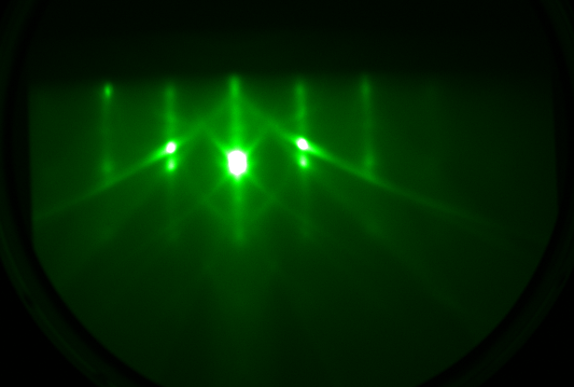
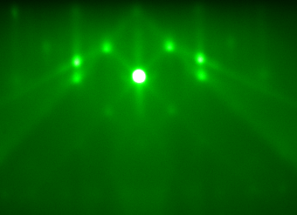
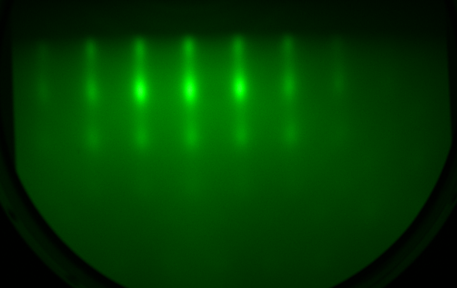
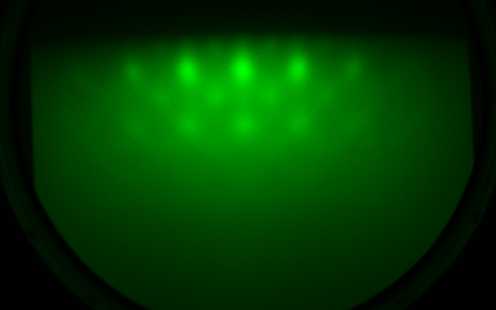
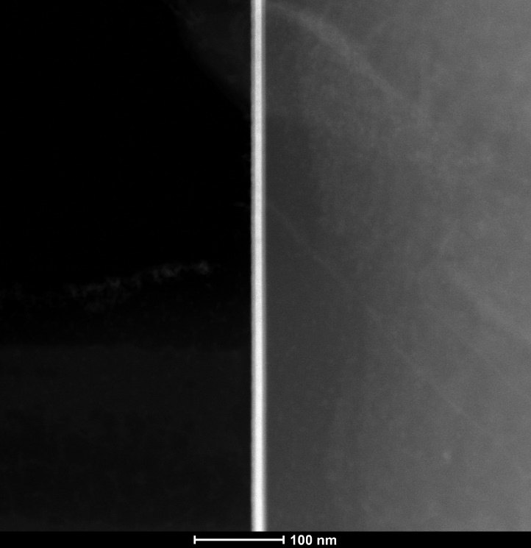
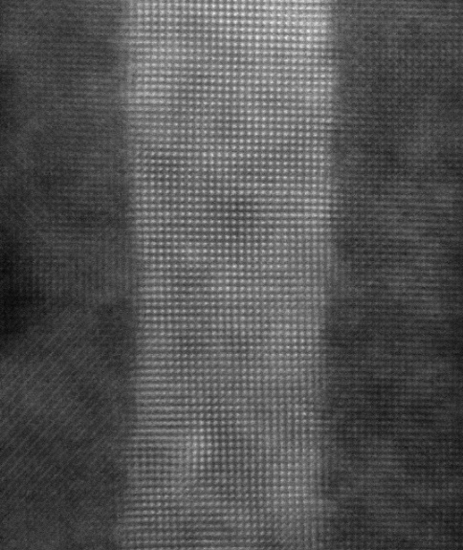
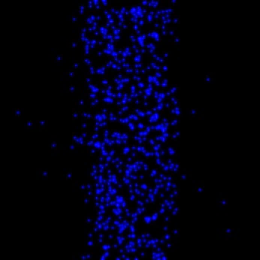
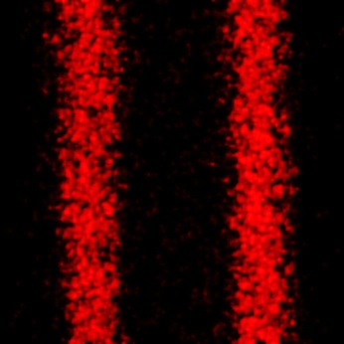
Figure 1
(a)
Fe
Cd
O
(b)
(c)
Fe₃O₄
MgO [100]
Bottom-Fe₃O₄ [100]
CdO
…
(d)
(e)
…
…
…
Fe₃O₄
(f)
CdO [100]
Top-Fe₃O₄ [100]
(g)
Fe₃O₄
CdO
Fe₃O₄
100 nm
(h)
Cd
(i)
Fe
2 nm
Notes:
Basic information

Slide 2
Figure 2
(a)
(b)
(c)
E
R_{S} (Ω □⁻¹)
M/M_{S}
8 UC Fe₃O₄
Cd’s 5s
Fe’s t_{2g}
4 UC Fe₃O₄
E_{f}
4 UC Fe₃O₄
15 UC CdO
15 UC CdO
4 UC Fe₃O₄
4 UC Fe₃O₄
R_{S} (Ω □⁻¹)
ρ_{AH} (Ω)
O’s 2p
Fe’s e_{g}
T (K)
B (T)

Slide 3
Figure 3
(a)
T = 10 K
B
I
Δρ/ρ(B=0)
B
3×10⁻⁴
I
(b)
B (T)
0.12
0.09
Δρ/ρ(B=0) (10⁻⁴)
B_{peak} (T)
0.06
0.03
0
T (K)

Slide 4
Figure 4
(a)
(b)
Fe₃O₄
CdO
d
Fe₃O₄
ρ_{xx} (Ω•cm)
Δρ/ρ(B=0)
T = 10 K
(c)
T (K)
(d)
d_{CdO} (UC)
ρ_{AH} (Ω)
σ_{AH} (Ω⁻¹•cm⁻¹)
20 UC
10 UC
T = 10 K
B (T)
d_{CdO} (UC)

